Slide 1
Chapter 3 Managing Your Time, Energy, and Money

Slide 2

Assess Your Strengths and Set Goals
Time management is challenging for almost all college students. What time-management tools do you use? How do you set and manage your priorities?
Use this chapter to help you develop some strategies and develop goals that relate to time management.

Slide 3

Managing Your Time
People approach the concept of time differently based on their personalities and backgrounds.
The first step of effective time management is to take control of your time.
Locus of control can be internal or external.
Use a calendar or planner.
Using your memory as your only planner means forgetting important events and deadlines.

Slide 4
Time-Management Tools
An academic calendar shows all the important dates specific to your campus.
Make note of important dates and deadlines.
Review syllabus and create preview; record daily commitments.
Use different colors for each category.
Create monthly, weekly, and daily calendar views.

Slide 5

http://drive.google.com/file/d/1b97Yu4OUVuR8KGIS6wxHWMuD0a80vEB_/view

Slide 6
Schedule Tips
Reserve study time for each class and each assignment
Allow for emergencies by finishing before due dates
Schedule time for both work and pleasure
Notes:
Instructors: Other tips to share include:
Remember you may have to rearrange your schedule a few times
Provide details

Slide 7
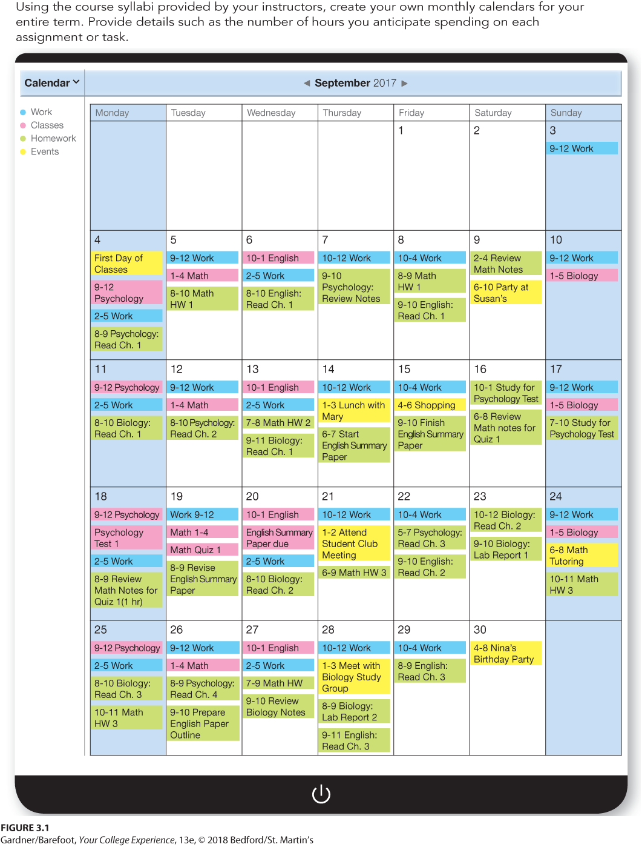
Sample Monthly Schedule

Slide 8
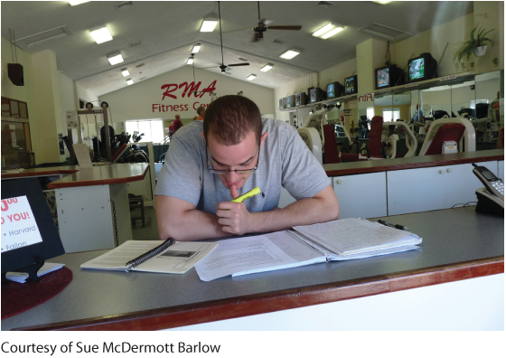
Time-Management Tips
When organizing your day:
Use waiting, commuting, and travel time to review
Limit distracting and time-consuming communications
Avoid multitasking
What times of day are you most productive? When do you prefer to study?
Notes:
Other tips include:
Set realistic goals
Be flexible

Slide 9
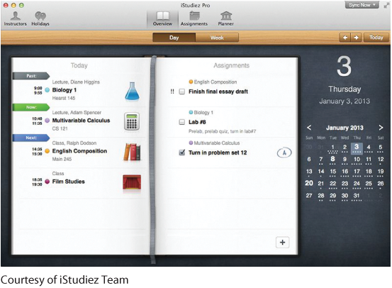
Tech Tip: Get Digitally Organized
A free electronic calendar or phone app can help you stay organized without needed to keep track of a paper planner. Some tips for digital organizers:
Select the device and platform you would be most likely to use.
Use collected information to set up your electronic calendar.
Pick a time every week to review your schedule.
Notes:
Instructors: Other steps from the text include:
Collect schedule information to determine important dates
An optional tip is to include work schedules or other regular commitments
Remind students that setting up a schedule at the beginning of the term takes time.

Slide 10
Procrastination
Procrastination is the habit of delaying something that needs immediate attention
Reasons students procrastinate:
Easily distracted
View the assigned task as too far into the future
Consider the task boring, irrelevant, or busy work
Can you identify other reasons why students might procrastinate?
Notes:
Instructors: Use the question in the slide to generate class discussion. Other reasons for distraction listed in the chapter include:
Perfectionism
Difficulty organizing and regulating their lives
Difficulty following through on goals
Fear of failure or success

Slide 11
Overcoming Procrastination
Tips to overcome procrastination:
Avoid doing things that might seem more fun
Shut off and put away all electronic devices
Say no to friends and family members
Energy management often requires the use of the word “no.” How does saying no relate to the way you can manage your energy? Is it easy to say no to family and friends?
Notes:
Other tips included in the chapter are:
Remind yourself of the consequences
Create a to-do list
Break down big jobs into smaller steps
Find a comfortable place to study without distractions

Slide 12

Managing Your Energy
Energy is an essential resource and we have a choice in how we use it:
Recognize your daily pattern and establish a routine around it
Eat healthy snacks and drink plenty of water
Schedule down-time for naps and relaxing activities

Slide 13
Setting Priorities
You will have to learn how to prioritize, or, put your tasks, goals, and values in order of importance. To set priorities:
Determine which goals are urgent and important
Find a balance between your academic and personal schedules
Don’t overextend yourself with more work than you can handle
Stay focused on your purpose
Notes:
Instructors: To generate class discussion, ask students to discuss how they know when they are overextended. Ask whether they need to relinquish any commitments and will any negative consequences result from giving up these commitments?
Another class activity would be to ask each student to list their priorities and assign a value of importance to each activity on a scale from 1 (most important) to 5 (least important).

Slide 14
Appreciating the Value of Time
Time is a valuable resource and punctuality, being on time is expected in college, work, and elsewhere.
Basic guidelines for respectful behavior in class:
Get to class on time.
Be on time for scheduled appointments.
Avoid behaviors that show a lack of respect.
Make transportation plans in advance.

Slide 15
Creating a Workable Class Schedule
Building your class schedule so that it works for you is part of using your valuable time wisely.
Questions to ask yourself:
When do I want to schedule breaks for relaxation or spending time with friends?
Do I want to avoid returning to my residence hall between classes?
How much time do I need to allot in order to get from one class to another?

Slide 16
Scheduling Your Classes in Blocks
Benefits:
Allows you to cut travel time if you commute
Might provide more flexibility for other commitments
Drawbacks:
Possible fatigue from sitting in classes all day
Risk of multiple exams on the same day
Can you think of any other benefits and drawbacks to block scheduling? What is your opinion on block scheduling?
Notes:
Instructors: Please explain to students that block scheduling involves scheduling classes back-to-back, without any breaks. Use the questions to generate class discussion. Other possible drawbacks listen in the chapter include:
If ill on a class day, could fall behind in all of your classes
Limits study time between classes

Slide 17

Living on a Budget
A budget is a spending plan that tracks all sources of income and expenses during a set period of time.
Creating and following a budget allows you to:
Pay your bills on time
Cut costs
Put some money away for emergencies
Finish college with as little debt as possible

Slide 18
Create a Budget
Some tips to get started:
Gather income information.
Gather expense information for college or university.
Gather information about living expenses.
Find out how you are doing.
Make adjustments.

Slide 19
Cut Costs
Recognize the difference between needs and wants.
Seek out discount entertainment options.
Embrace secondhand goods.
What are other ways you can cut costs?
Notes:
Instructors: Use the question in the slide to generate a class discussion on cutting costs. Other suggestions from the chapter include:
Share expenses.
Consider the pros and cons of living on campus.
Use low-cost transportation.
Avoid unnecessary fees.

Slide 20

Understanding Financial Aid
There are different types of financial aid available to help with the cost of college:
Grant
Scholarship
Work-study program
Cooperative (co-op) education

Slide 21

http://drive.google.com/file/d/1hwEZJZlVSKus_-tJoqDE1n2CXzCXS93p/view

Slide 22
Navigating Financial Aid
Financial aid office can help find:
Largest amount of money that doesn’t need to be repaid
Lowest interest rate on loans
Work opportunities that fit your academic program
Most students pay for college with a combination of types of financial assistance

Slide 23
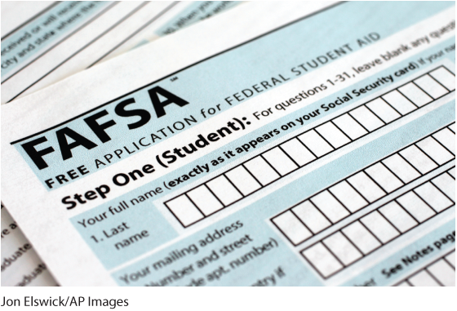
FAFSA
The Free Application for Federal Student Aid (FAFSA) is used to determine the amount of financial aid you will receive.
Complete by the earliest deadline

Slide 24
Qualifying for Financial Aid
Enroll half time or more.
Complete the FAFSA.
Complete the College Board PROFILE form if required.
Complete the classes for which you were given financial aid with the required minimum GPA.
Notes:
Other steps to qualify for financial aid are:
Complete any additional required applications.
Follow instructions carefully and submit each application on time.

Slide 25
How to Keep Your Funding
File for financial aid every year and meet all filing deadlines.
Talk with a financial aid officer immediately if you or your family experiences a significant loss.
Inquire every year about criteria-based aid.
Consider asking for reassessment of eligibility.

Slide 26
Achieving a Balance between Working and Borrowing
Each term or year, you should decide how much you can work while maintaining good grades, or how much you should borrow from student loans.
There are advantages and disadvantages to both working and borrowing.

Slide 27
Working
Advantages of working:
Earn money
Typically better grades for students who work 15 to 20 hours per week
Disadvantages of working
Very difficult to get great grades if you work full-time while trying to be a full-time student
Part-time off-campus jobs that relate to your major or career plan hard to come by
Notes:
Other advantages of working:
Develop a credential for graduate school
Become more employable later
Explore career options
Disadvantage of working:
On-campus jobs typically pay less than off-campus jobs

Slide 28
Borrowing
Subsidized federal student loans
Backed by the government
Government pays loan interest while in school
Unsubsidized federal student loans
May require you to make interest payments while in school
Alternatively, interest may be added to amount owed

Slide 29
Other Loans
Parent Loan for Undergraduate Students (PLUS loans)
Applied for and owed by parents
Disbursed directly to students
Interest usually higher than federal, but lower than private loans
Private student loans
Offered through banks and credit unions
Often have stricter credit requirements and higher interest rates
Interest payments begin immediately

Slide 30

Managing Credit Wisely
Your credit score is derived from a credit report that contains information about accounts in your name
Understanding credit:
Beware of making only a minimum payment.
Avoid making late payments.
Use credit cards only to build credit and for emergencies.

Slide 31
Debit Cards
Benefits of debit cards:
You don’t always have to carry cash.
The amount of purchases will be limited to the funds in your bank.
Disadvantage of debit cards:
Provides direct access to your checking account
Do you prefer credit or debit cards?
Notes:
Instructors: Use the question in the slide to generate class discussion about student preferences and the advantages and disadvantages or credit and debit cards.

Slide 32
Tech Tip: Master Budgeting, Version 2.0!
Technology can help you keep track of your money:
Check with your banking institution about apps and online tools
Beware of scams.
Do not answer questions over the phone if you didn’t originate the call.
Do not reply to e-mail, pop-ups, or text messages that ask for personal information.
Notes:
Other tips to be aware of:
Do not transmit personal information through e-mail.
Never click on links in unsolicited e-mails.
Use good judgment.

Slide 33
Planning for the Future
It’s never too early to begin thinking about how you will finance your life after graduation. Some tips:
Plan now for your next step, whether it’s additional education or work.
Keep your address current with the registrar.
Establish a savings account and add to it regularly.

Slide 34
Reflection
Make sure that you set clear priorities for the way you spend your time.
Remember the relationship between time and respect.
Think about your course schedule. Are you happy with your current schedule? If your current schedule is not working, what changes could you make for next term?
Make learning financial-literacy skills a priority.

